Slide 1
Bagging and Boosting
Copyright © www.ITbodhi.com

Slide 2
Bagging and Boosting
Bagging and Boosting are similar in that they are both ensemble techniques, where a set of weak learners are combined to create a strong learner that obtains better performance than a single one.
Copyright © www.ITbodhi.com

Slide 3
ENSEMBLE LEARNING
Ensemble methods combine several decision trees classifiers to produce better predictive performance than a single decision tree classifier. The main principle behind the ensemble model is that a group of weak learners come together to form a strong learner, thus increasing the accuracy of the model.
When we try to predict the target variable using any machine learning technique, the main causes of difference in actual and predicted values are noise, variance, and bias. Ensemble helps to reduce these factors (except noise, which is irreducible error).
Copyright © www.ITbodhi.com

Slide 4
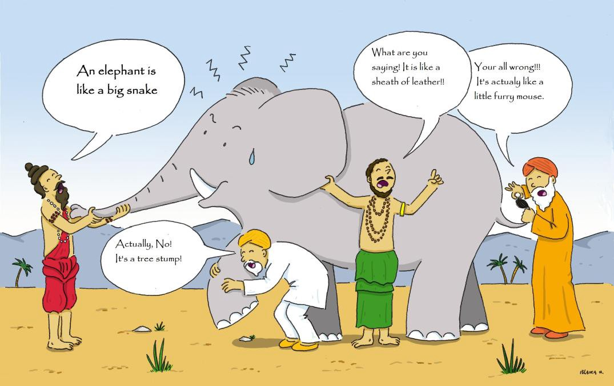
Copyright © www.ITbodhi.com

Slide 5
Using techniques like Bagging and Boosting helps to decrease the variance and increased the robustness of the model.
Combinations of multiple classifiers decrease variance, especially in the case of unstable classifiers, and may produce a more reliable classification than a single classifier.
Copyright © www.ITbodhi.com

Slide 6
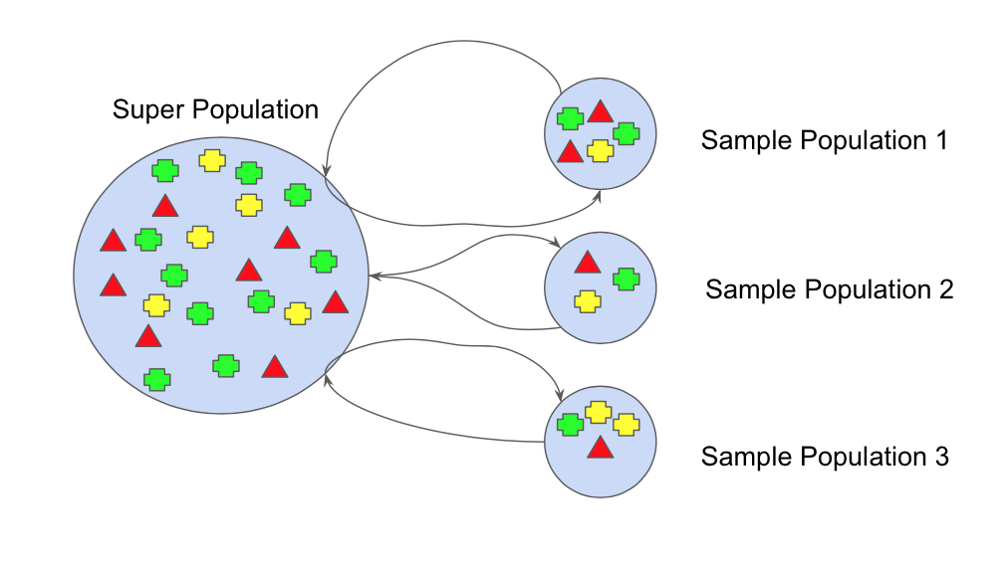
BOOTSTRAPPING
Bootstrap refers to random sampling with replacement. Bootstrap allows us to better understand the bias and the variance with the dataset.
Bootstrap involves random sampling of small subset of data from the dataset.
This subset can be replaced.
The selection of all the example in the dataset has equal probability.
Copyright © www.ITbodhi.com

Slide 7
BAGGING
Bootstrap Aggregation (or Bagging for short), is a simple and very powerful ensemble method. Bagging is the application of the Bootstrap procedure to a high-variance machine learning algorithm, typically decision trees.
Suppose there are N observations and M features. A sample from observation is selected randomly with replacement(Bootstrapping).
A subset of features are selected to create a model with sample of observations and subset of features.
Feature from the subset is selected which gives the best split on the training data.
This is repeated to create many models and every model is trained in parallel
Prediction is given based on the aggregation of predictions from all the models.
Copyright © www.ITbodhi.com

Slide 8
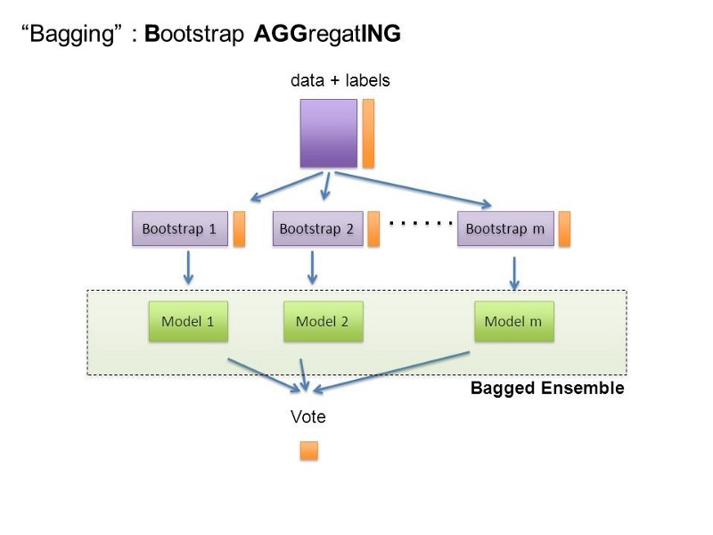
Copyright © www.ITbodhi.com

Slide 9
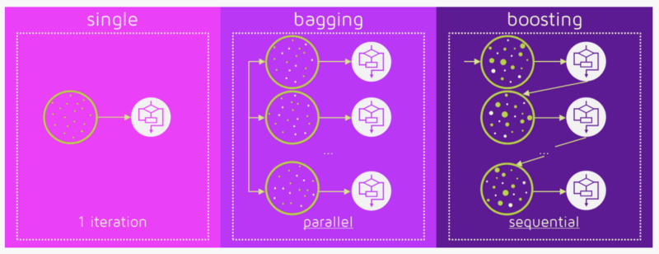
Copyright © www.ITbodhi.com

Slide 10
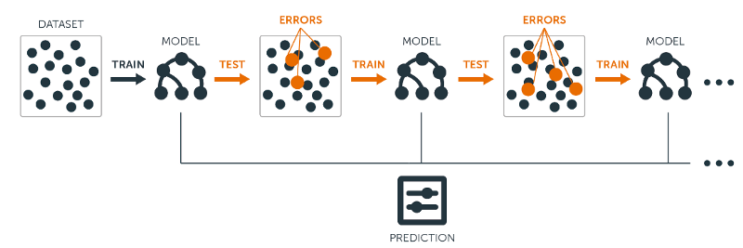
Copyright © www.ITbodhi.com

Slide 11
What does Ada-boost classifier do?
Ada-boost classifier combines weak classifier algorithm to form strong classifier. A single algorithm may classify the objects poorly. But if we combine multiple classifiers with selection of training set at every iteration and assigning right amount of weight in final voting, we can have good accuracy score for overall classifier.
In short Ada-boost ,
retrains the algorithm iteratively by choosing the training set based on accuracy of previous training.
The weight-age of each trained classifier at any iteration depends on the accuracy achieved.
Copyright © www.ITbodhi.com

Slide 12
How do we select the training set?
Each weak classifier is trained using a random subset of overall training set.
Random subset is not actually 100% random. After training a classifier at any level, ada-boost assigns weight to each training item.
Misclassified item is assigned higher weight so that it appears in the training subset of next classifier with higher probability.
After each classifier is trained, the weight is assigned to the classifier as well based on accuracy.
More accurate classifier is assigned higher weight so that it will have more impact in final outcome.
Copyright © www.ITbodhi.com

Slide 13
How to assign weight to each classifier?
A classifier with 50% accuracy is given a weight of zero, and a classifier with less than 50% accuracy is given negative weight.
Copyright © www.ITbodhi.com

Slide 14
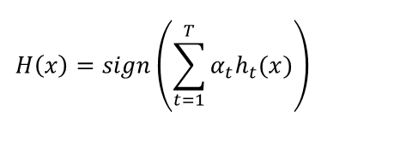
Lets look at the mathematical formula and parameters.
h_t(x) is the output of weak classifier t for input x
alpha_t is weight assigned to classifier.
alpha_t is calculated as follows:
alpha_t = 0.5 * ln( (1 — E)/E) : weight of classifier is straigt forward, it is based on the error rate E.
Copyright © www.ITbodhi.com

Slide 15
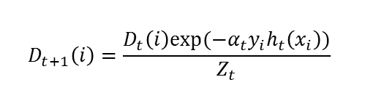
Updating weight of training examples
Initially, all the input training example has equal weightage.
After weak classifier is trained, we update the weight of each training example with following formula
D_t is weight at previous level.
We normalize the weights by dividing each of them by the sum of all the weights, Z_t. For example, if all of the calculated weights added up to 15.7, then we would divide each of the weights by 15.7 so that they sum up to 1.0 instead.
y_i is y par of training example (x_i, y_i) y coordinate for simplicity.
Copyright © www.ITbodhi.com

Slide 16
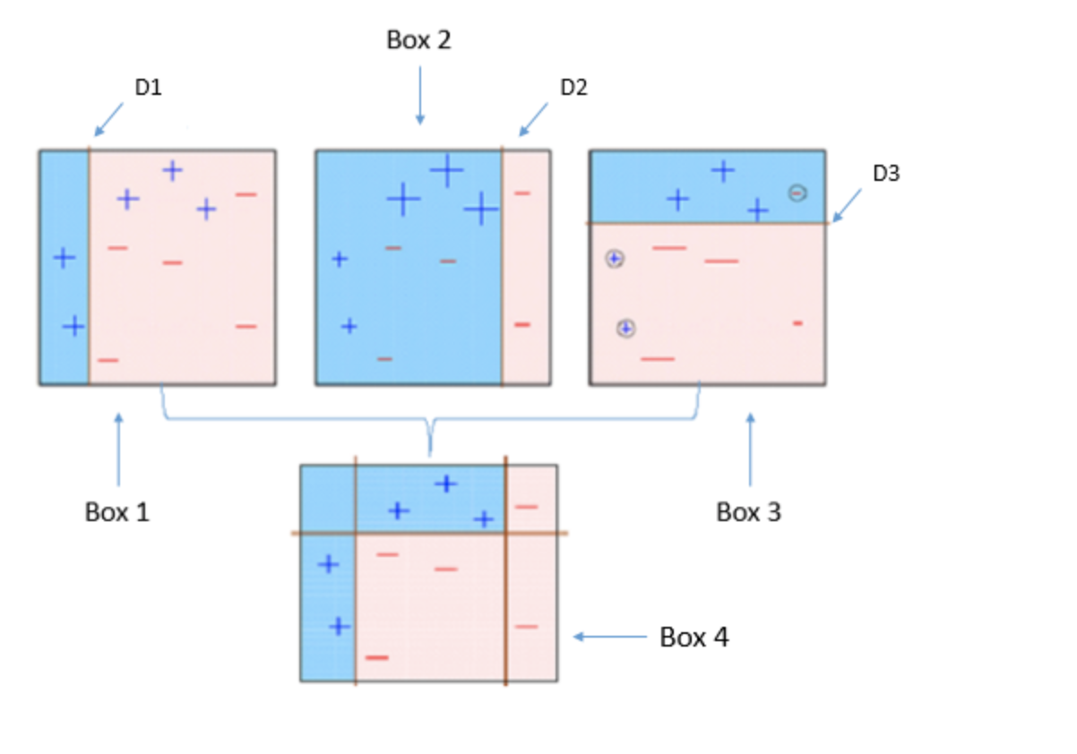
Copyright © www.ITbodhi.com

Slide 17
Box 1: You can see that we have assigned equal weights to each data point and applied a decision stump to classify them as + (plus) or — (minus). The decision stump (D1) has generated vertical line at left side to classify the data points. We see that, this vertical line has incorrectly predicted three + (plus) as — (minus). In such case, we’ll assign higher weights to these three + (plus) and apply another decision stump.
Box 2: Here, you can see that the size of three incorrectly predicted + (plus) is bigger as compared to rest of the data points. In this case, the second decision stump (D2) will try to predict them correctly. Now, a vertical line (D2) at right side of this box has classified three mis-classified + (plus) correctly. But again, it has caused mis-classification errors. This time with three -(minus). Again, we will assign higher weight to three — (minus) and apply another decision stump.
Box 3: Here, three — (minus) are given higher weights. A decision stump (D3) is applied to predict these mis-classified observation correctly. This time a horizontal line is generated to classify + (plus) and — (minus) based on higher weight of mis-classified observation.
Box 4: Here, we have combined D1, D2 and D3 to form a strong prediction having complex rule as compared to individual weak learner. You can see that this algorithm has classified these observation quite well as compared to any of individual weak learner.
Copyright © www.ITbodhi.com

Slide 18
Below are the steps for performing the AdaBoost algorithm:
Initially, all observations are given equal weights.
A model is built on a subset of data.
Using this model, predictions are made on the whole dataset.
Errors are calculated by comparing the predictions and actual values.
While creating the next model, higher weights are given to the data points which were predicted incorrectly.
Weights can be determined using the error value. For instance, the higher the error the more is the weight assigned to the observation.
This process is repeated until the error function does not change, or the maximum limit of the number of estimators is reached.
Copyright © www.ITbodhi.com

Slide 19
Hyperparameters
base_estimators: specifies the base type estimator, i.e. the algorithm to be used as base learner.
n_estimators: It defines the number of base estimators, where the default is 10 but you can increase it in order to obtain a better performance.
learning_rate : same impact as in gradient descent algorithm
max_depth : Maximum depth of the individual estimator
Copyright © www.ITbodhi.com

Slide 20
Gradient Boosting
Gradient Boosting works by sequentially adding the previous predictors underfitted predictions to the ensemble, ensuring the erros made previously are corrected.
The difference lies in what it does with the underfitted values of its predecessor. Contrary to AdaBoost, which tweaks the instance weights at every interaction, this method tries to fit the new predictor to the residual errors made by the previous predictor.
Copyright © www.ITbodhi.com

Slide 21
Below are the steps for performing the Gradien Boosting algorithm:
A model is built on a subset of data.
Using this model, predictions are made on the whole dataset.
Errors are calculated by comparing the predictions and actual values.
A new model is created using the errors calculated as target variable. Our objective is to find the best split to minimise the error.
The predictions made by this new model are combined with the predictions of the previous.
New errors are calculated using this predicted value and actual value.
This process is repeated until the error function does not change, or the maximum limit of the number of estimators is reached.
Copyright © www.ITbodhi.com

Slide 22
Gradient boosting is a machine learning technique for regression and classification problems, which produces a prediction model in the form of an ensemble of weak prediction models, typically decision trees.
The objective of any supervised learning algorithm is to define a loss function and minimize it.
Copyright © www.ITbodhi.com

Slide 23
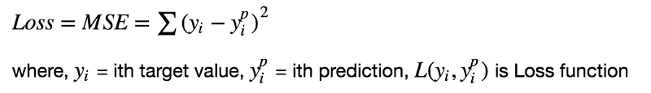
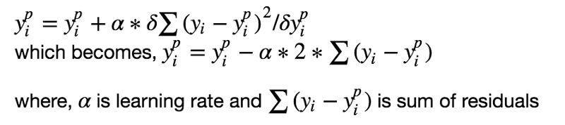
We want our predictions, such that our loss function (MSE) is minimum. By using gradient descent and updating our predictions based on a learning rate, we can find the values where MSE is minimum.
Copyright © www.ITbodhi.com

Slide 24
We are basically updating the predictions such that the sum of our residuals is close to 0 (or minimum) and predicted values are sufficiently close to actual values.
Copyright © www.ITbodhi.com

Slide 25
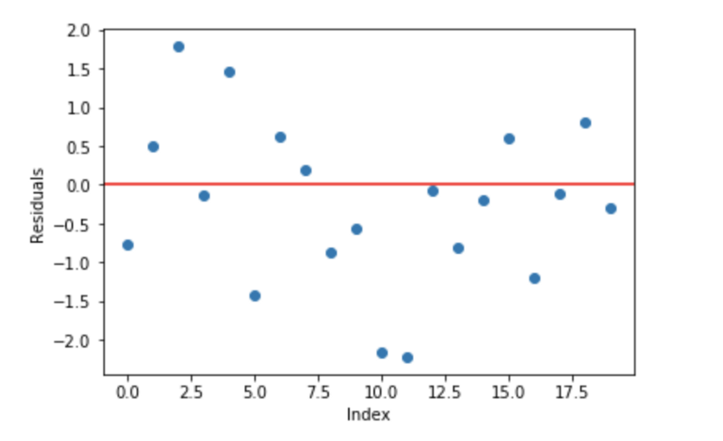
Intuition behind Gradient Boosting
A basic assumption of linear regression is that sum of its residuals is 0, i.e. the residuals should be spread randomly around zero.
Copyright © www.ITbodhi.com

Slide 26
Now think of these residuals as mistakes committed by our predictor model, we might argue that, if we are able to see some pattern of residuals around 0, we can leverage that pattern to fit a model.
So, the intuition behind gradient boosting algorithm is to repetitively leverage the patterns in residuals and strengthen a model with weak predictions and make it better.
Once we reach a stage that residuals do not have any pattern that could be modeled, we can stop modeling residuals (otherwise it might lead to overfitting). Algorithmically, we are minimizing our loss function, such that test loss reach its minima.
Copyright © www.ITbodhi.com

Slide 27
In summary,
• We first model data with simple models and analyze data for errors. • These errors signify data points that are difficult to fit by a simple model. • Then for later models, we particularly focus on those hard to fit data to get them right. • In the end, we combine all the predictors by giving some weights to each predictor.
Copyright © www.ITbodhi.com

Slide 28
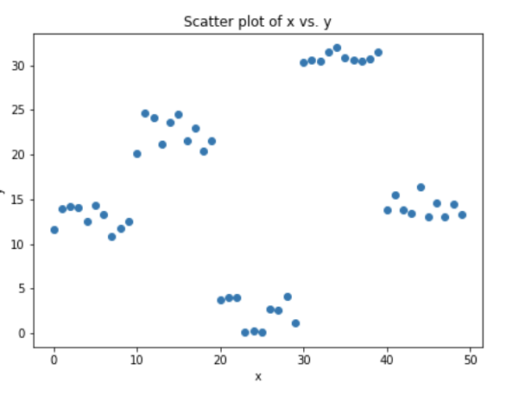
Steps to fit a Gradient Boosting model
Let’s consider simulated data as shown in scatter plot below with 1 input (x) and 1 output (y) variables.
Copyright © www.ITbodhi.com

Slide 29
Fit a simple linear regressor or decision tree on data [call x as input and y as output]
Calculate error residuals. Actual target value, minus predicted target value [e1= y - y_predicted1 ]
Fit a new model on error residuals as target variable with same input variables [call it e1_predicted]
Add the predicted residuals to the previous predictions [y_predicted2 = y_predicted1 + e1_predicted]
Fit another model on residuals that is still left. i.e. [e2 = y - y_predicted2] and repeat steps 2 to 5 until it starts overfitting or the sum of residuals become constant. Overfitting can be controlled by consistently checking accuracy on validation data.
Copyright © www.ITbodhi.com

Slide 30
Visualization of working Gradient Boosting Tree
Blue dots (left) plots are input (x) vs. output (y) • Red line (left) shows values predicted by decision tree • Green dots (right) shows residuals vs. input (x) for ith iteration • Iteration represent sequential order of fitting gradient boosting tree
Copyright © www.ITbodhi.com

Slide 31
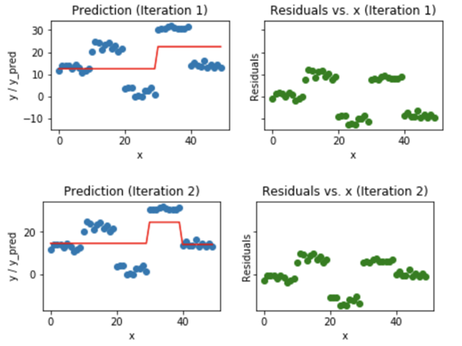
Copyright © www.ITbodhi.com

Slide 32
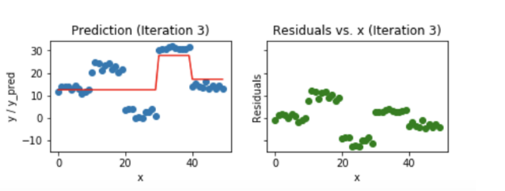
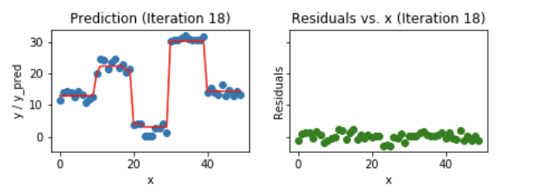
Copyright © www.ITbodhi.com

Slide 33
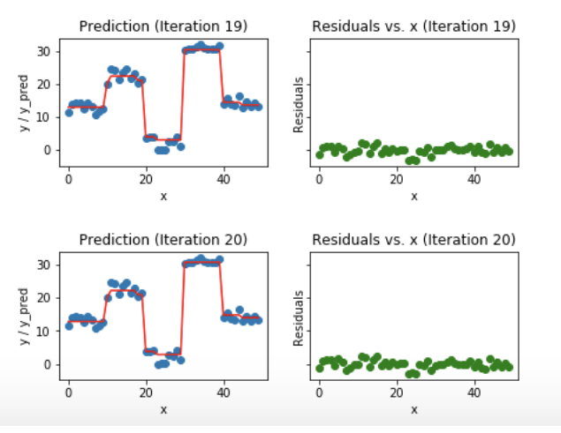
Copyright © www.ITbodhi.com

Slide 34
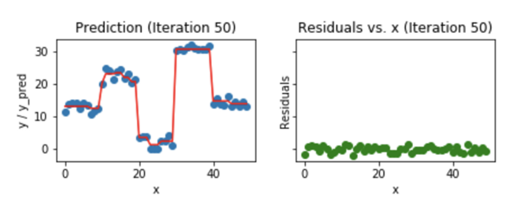
We observe that after 20th iteration , residuals are randomly distributed around 0 and our predictions are very close to true values.
(iterations are called n_estimators in sklearn implementation). This would be a good point to stop or our model will start overfitting.
Let’s see how our model look like for 50th iteration.
Copyright © www.ITbodhi.com

